Slide 1
Capstone - II
Campaign Communication :Classification of Potential Customers

Slide 2
Problem Identification:
Conducted campaigns are based mostly on direct phone calls, offering bank client to place a term deposit
So we need to predict future results of marketing companies based on available statistics to identify potential customers
Therefore, we need to classify the client will subscribe a bank term deposit or not for future campaign, to identify success of Bank Telemarketing

Slide 3
Recommendation
To optimize Campaign, there is need to concentrate on those consumer groups that are potentially more promising.
If we look from marital perspective, Married People have subscribed the product most. People who are admins have subscribed the product most.

Slide 4
Modelling Results and Analysis
I have Standardize the magnitude of numeric features, Split into testing and training datasets and applied scaler to the testing set.
It is observed Employee Variation rate, Euribor and Numbers of employee features are highly correlated.
The Data was highly imbalanced, therefore also used balancing techniques to apply the model and classify the customers
Final classifier could achieve accuracy rate 0.80. For such problems, along with accuracy score, recall and F1 score plays very important role for true values. Our model is able to successfully identify 68% of true positives, which could lead to identify only those potential customers who are more likely to convert.

Slide 5
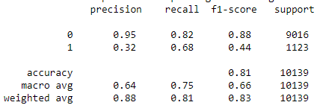
Precision & Recall Matrix
After evaluating best models after hyperparameter tuning, the model with best combination for our recall and F1 score is SVM. We got recall score of 68 and F1 score of 44.

Slide 6
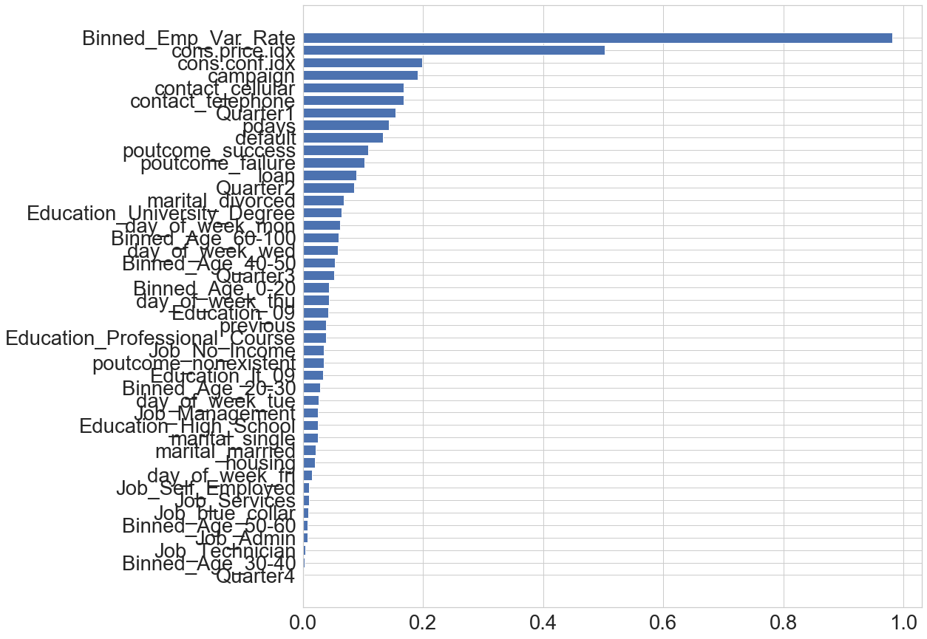
Important Features

Slide 7
Important Features
Most important factors that responsible to for customer to subscribe product are:
Financial Factors
Employee Variation Rate at the time of campaign for the customer category
Consumer Price Index at the time of campaign for the customer category
Consumer Confidence Index at the time of campaign for the customer category
Previous Contacts done to Customer
Time of the year (Quarter 1 seems to be more effective)

Slide 8
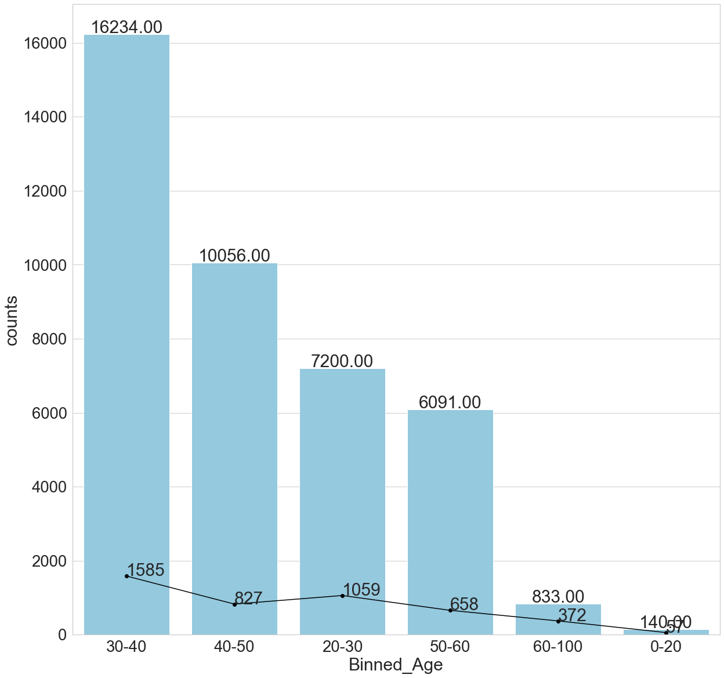
Most Promising Customers
Customers whose age is between 20-50 are most likely to subscribe the product

Slide 9
Summary & Conclusion
Concentrate on those consumer groups that are potentially more promising.
Customer should be filtered after analyzing the features which are more likely to subscribe
Employee Variation Rate at the time of campaign plays an important role
As future improvement, different approach could be followed to fill missing values, Dataset could be label encoded and algorithms could be applied to classify customers.

